Slide 1

ECE2050 Digital Logic and Systems Tutorial 4
Yao Junguang
Contact: junguangyao@link.cuhk.edu.cn Office Hour: 14:00-15:00 Tuesday, Rx902

Slide 2
Boolean Algebra and Logic Simplification
Outline
Intro to laws, rules and theorem about Boolean algebra
How to simplify the expressions

Slide 3
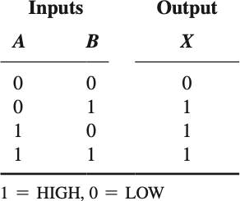
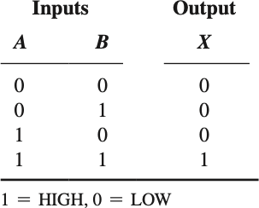
Boolean Algebra and Logic Simplification
Boolean Operations and Expressions
- Addition -> OR; Multiplication -> AND
OR
AND

Slide 4
Boolean Algebra and Logic Simplification
Laws of Boolean Algebra
Commutative laws
A + B = B + A; AB = BA
Associative laws
A + (B + C) = (A + B) + C; A(BC) = (AB)C
Distributive law A(B + C) = AB + AC

Slide 5
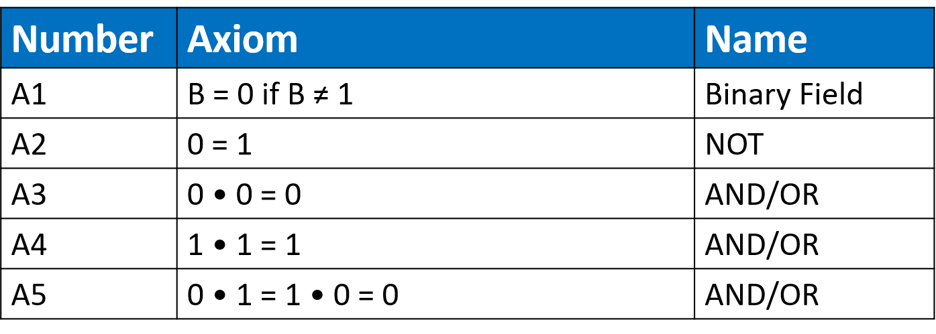
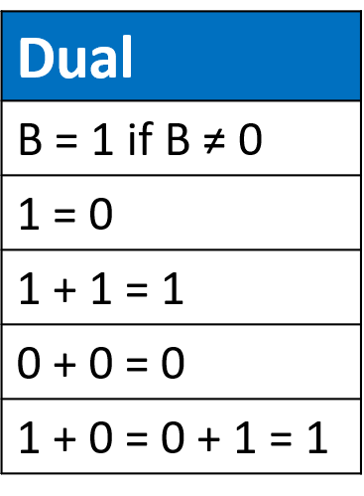
Boolean Algebra and Logic Simplification
Boolean Operations and Expressions
Dual: Replace: • with +
0 with 1

Slide 6
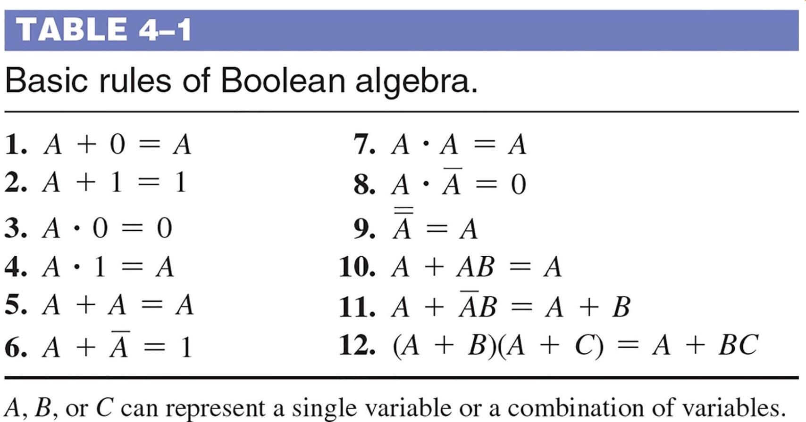
Boolean Algebra and Logic Simplification
Rules of Boolean Algebra

Slide 7
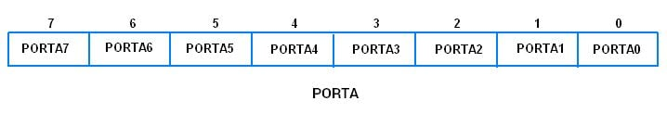
Boolean Algebra and Logic Simplification
Rules of Boolean Algebra-Extension
Register in Chip
11011110
11010110
11010100

Slide 8





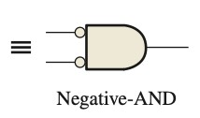
Boolean Algebra and Logic Simplification
DeMorgan’s Theorems

Slide 9
Boolean Algebra and Logic Simplification
Q1: Using Boolean Algebra to simplify the expression:

Slide 10
Boolean Algebra and Logic Simplification
Q1: Using Boolean Algebra to simplify the expression:
A1:
BC + DE (use rule 6 and 11.)

Slide 11
Boolean Algebra and Logic Simplification
Standard Forms of Boolean Expressions
SOP: Sum-of-Products
Standard SOP Form: Each product term has all variables
POS: Product-of-Sums
SOP form: A+BC
NOT SOP form: A+B(A+C)
Standard SOP form: ABC+ABC

Slide 12
Boolean Algebra and Logic Simplification
Boolean Expressions and Truth Tables
Q2: Develop the truth table and the standard POS expression:

Slide 13
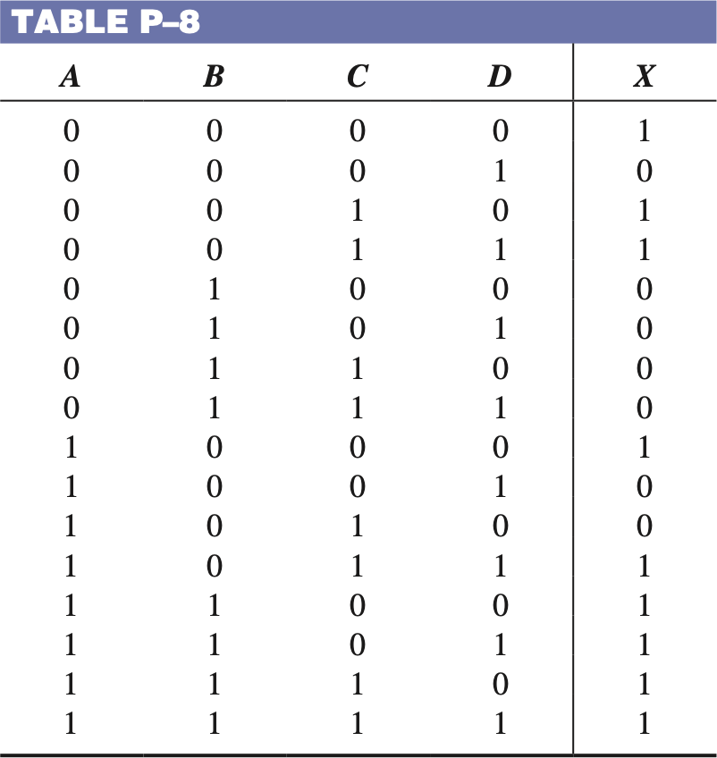
Boolean Algebra and Logic Simplification
Boolean Expressions and Truth Tables
Q2: Develop the truth table and the standard POS expression:
A2:

Slide 14
Boolean Algebra and Logic Simplification
The Karnaugh Map (K-Map)
Used to simplify Boolean expressions in a SOP/POS form.
Karnaugh maps can be used for expressions with two, three, four, and five variables, and the number of cells in a Karnaugh map indicates the number of possible input variable combinations.
- For three variables, the number of cells is 2³= 8. For four variables, the number of cells is 2⁴ = 16.
Adjacency is defined by a single-variable change between adjacent cells.

Slide 15
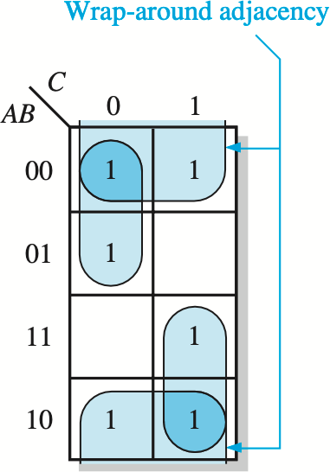
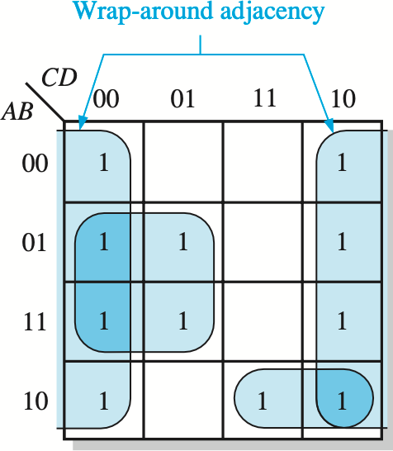
Boolean Algebra and Logic Simplification
Cell Adjacency of The Karnaugh Map (K-Map)
Each cell is adjacent to the cells that are immediately next to it on any of its four sides
Wrap-around adjacency

Slide 16
Boolean Algebra and Logic Simplification
SOP Minimization and POS Minimization
In SOP, focus on 1’s
In POS, focus on 0’s
Grouping
Goal: Maximize the size of the groups and to minimize the number of groups
The number of cells in a group should be powers of 2
Overlapping is allowed
Nonstandard SOP Expression
Expand each term

Slide 17
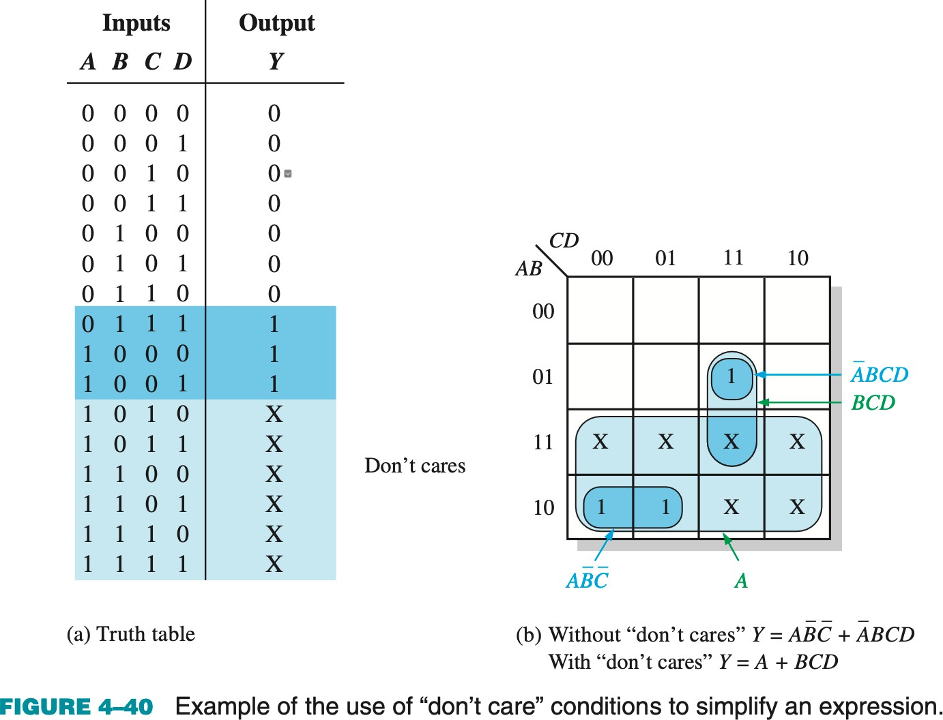
Boolean Algebra and Logic Simplification
“Don’t Care” Conditions
- some states will never occur in an application, they can be treated as “don’t care” terms.

Slide 18
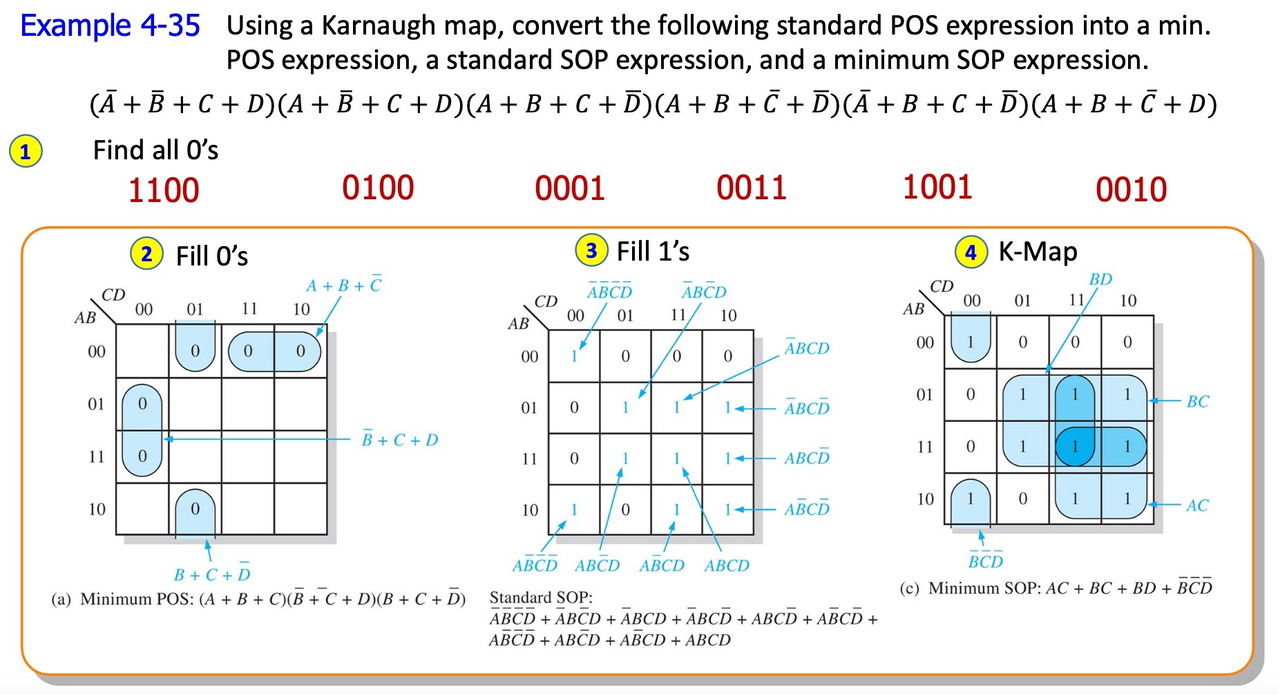
Boolean Algebra and Logic Simplification
Converting between POS and SOP with K-Map

Slide 19
Boolean Algebra and Logic Simplification
K-Map of SOP Minimization
Q3: Minimize the expression with a K-Map:

Slide 20
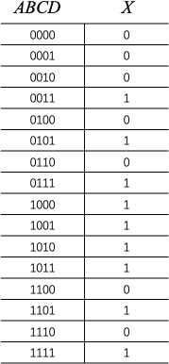
Boolean Algebra and Logic Simplification
K-Map of SOP Minimization
Q3: Minimize the expression with a K-Map:
CD ₀₀
01 11 10
A3: A𝐵 +BD+CD
AB
00
1
01
1 1
11
1
1
10
1 1 1 1
(You don’t have to draw a truth table if the question does not require)

Slide 21
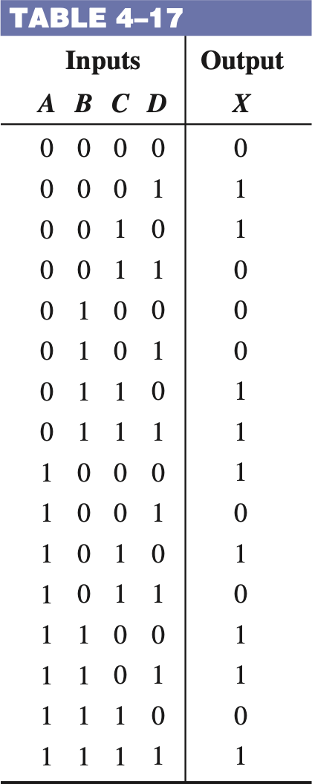
Boolean Algebra and Logic Simplification
K-Map of POS Minimization
Q4: Determine the minimum POS expression for the function in Table 4-17:

Slide 22
Boolean Algebra and Logic Simplification
K-Map of POS Minimization
Q4: Determine the minimum POS expression for the function in Table 4-17:
CD ₀₀
A4:
AB
01 11 10
00 | 0 |  | 0
01 | 0 | 0
11 |  |  |  | 0
10 |  | 0 | 0
$$(A+C+D)(A+\overline{B}+C)(\overline{A}+B+\overline{D})(B+\overline{C}+\overline{D})(\overline{A}+\overline{B}+\overline{C}+D)$$

Slide 23
Q&A

Slide 24
Thank You!

